Slide 1
BRITISH AIRWAYS
Web scraping to gain company insights
Scrape and analyse customer review data to uncover findings for British Airways

Slide 2
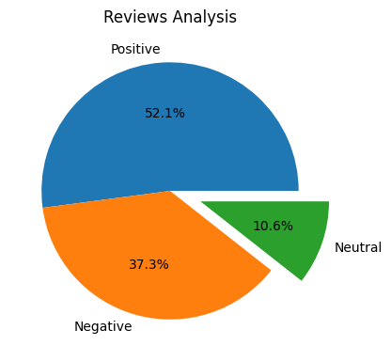
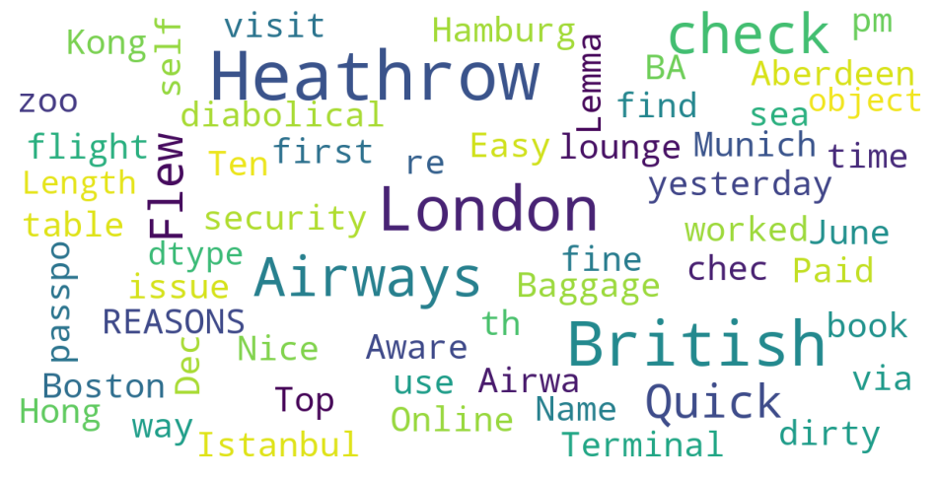
INSIGHTS FROM CUSTOMER REVIEWS
From cleaning 1000 reviews given by the customers, we obtained
Positive Reviews - 521
Negative Reviews - 373
Neutral Reviews – 106

